Slide 1
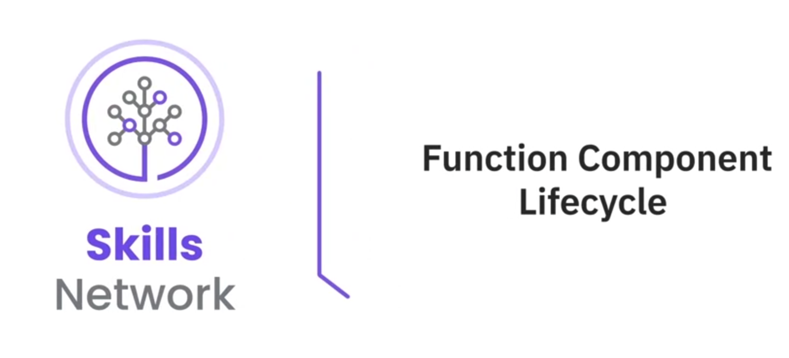

Slide 2


What you will learn
Define functional components in React
Recognize the four different phases of a functional component in React

Slide 3

Functional components in React
Functional components are building blocks for UI
Lifecycle understanding is crucial for:
Managing behavior and state of components

Slide 4

Functional components in React
Functional components lack traditional lifecycle methods
Similar functionalities achieved with hooks such as:
useState, useEffect, and useReducer

Slide 5

Mounting phase
Updating phase
Unmounting phase
Error handling phase

Slide 6

Mounting phase
React in the mounting phase:
Initializes the functional component
Prepares it for rendering on the DOM

Slide 7
Mounting phase
Steps involved :
Side effects
State initialization
Initialization

Slide 8
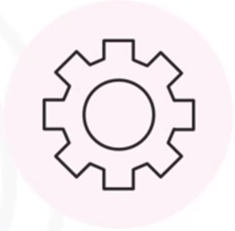
Steps: Mounting phase
Initialization :
React:
Runs function body of the functional component
Sets up the initial structure and behavior

Slide 9
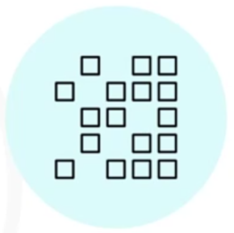
Steps: Mounting phase
State initialization :
React
Utilizes the useState hook
Declares and initializes state variables
Variables hold data, triggering re-renders

Slide 10

Side effects :
React:
• Includes data fetching, subscriptions, or DOM manipulation
• Utilizes the useEffect hook with ([])
• Ensures that side effects execute only once
• Optimizes performance and prevents unnecessary re-execution Loading

Slide 11

Updating phase :
React:
• Responds to changes in the component’s state
• Props by re-invoking function body of the component
• Triggers a re-evaluation of JSX

Slide 12

Updating phase
• Responds to user actions and state modifications
• Ensures your UI stays in sync with the underlying data

Slide 13

Unmounting phase
• Involves cleanup operations when removing a component
• Includes cleaning up event listeners, subscriptions, timers

Slide 14

Error handling
Error handling • Involves routing error to the nearest error boundary • Is the final phase of the functional component's lifecycle Error boundaries: • Catch errors during the rendering phase • Display a fallback UI • Ensures application remains functional despite the error

Slide 15
Recap
In this video, you learned that:
• React's lifecycle phases include mounting, updating, unmounting, and error handling
• The mounting phase initializes the component, sets up the initial state, and performs side effects
• In the updating phase, React re-invokes the function body and re-evaluates JSX
• In the unmounting phase, React executes cleanup operations when removing a component from the DOM

